Slide 1
Final Presentaion Joey L. McCrary Applied Mathematics, Southern New Hampshire University MAT430: Seminar in Applied Mathematics Dr. Timothy Smith August 14, 2023

Slide 2
Background
At the very start of this course, I had to execute a relocation to Tampa, FL and of all the expected price incurrences, the most surprising was the increase in auto insurance. While my own premium was expected to be high, it was my girlfriend’s premium increase that was jaw dropping. She is 31 with a clean driving record, no accidents, and drives a compact SUV…her premium was ~$700 more. So naturally, the question of why would arise.
Learning about how auto insurance premiums helps as a consumer especially since every six months, drivers are back in the market.

Slide 3

Research Question
Which factors of auto insurance premiums are most prolific?
Common factors that determine premiums include:
Gender, Credit Score, Marital Status, Driving Record, Annual Mileage, Age, Vehicle & Ownership type, Location, Insurance & Claims History, Coverage Level, and Insurance Company brand
Other factors such as education, military/first responder occupational history, and customer loyalty are excluded since they are usually included only as discounts applied after policy calculation

Slide 4
Acquired Data Set
The data set acquired for this research project came from Kaggle.com
Historical data set on Allstate customers from Maryland 2015
Includes 92792 observations over 11 factors
Territory Gender Birthdate (Age) Fixed Expenses
Years of Prior Coverage (YPC) Combined Grade Rating (CGR)
Underlying Premium Current Premium Selected Premium
Underlying Total Premium Indicated Premium

Slide 5
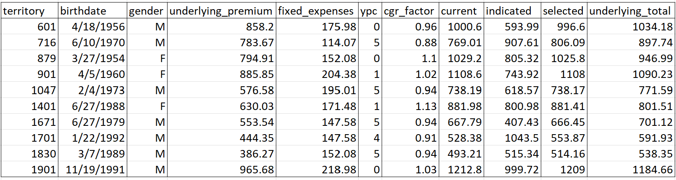
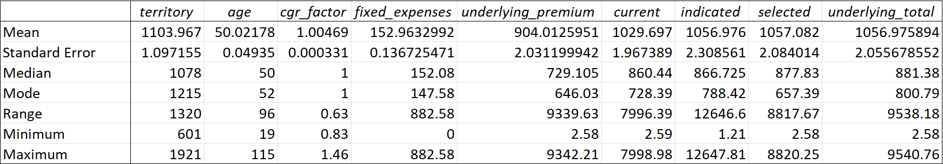
Data Preview & Summary

Slide 6
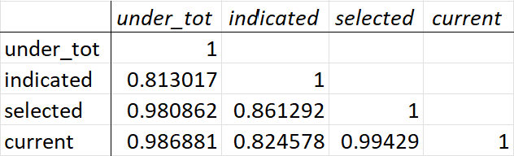
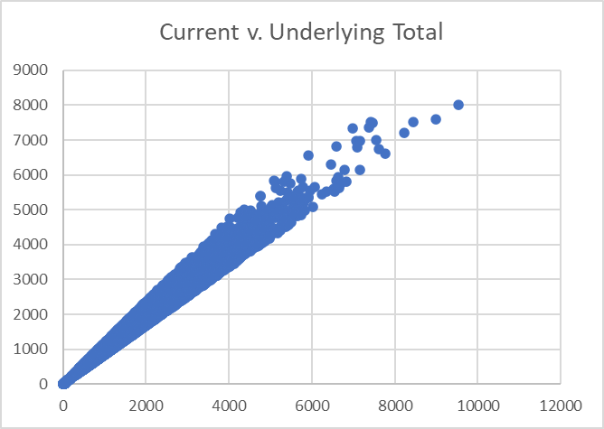
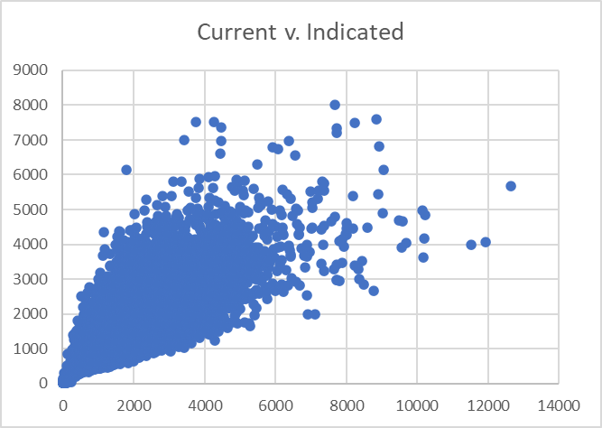
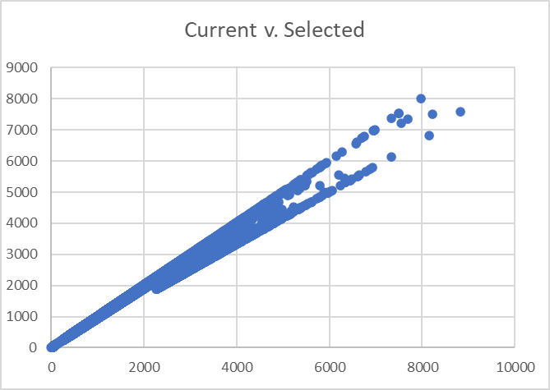
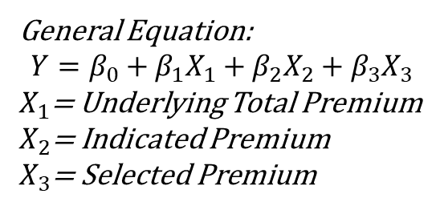
Initial Model Build
Correlation Matrix
General Equation:
$$Y=β_{0}+β_{1}X_{1}+β_{2}X_{2}+β_{3}X_{3}$$
$X_{1}$= Underlying Total Premium
$X_{2}$= Indicated Premium
$X_{3}$= Selected Premium

Slide 7
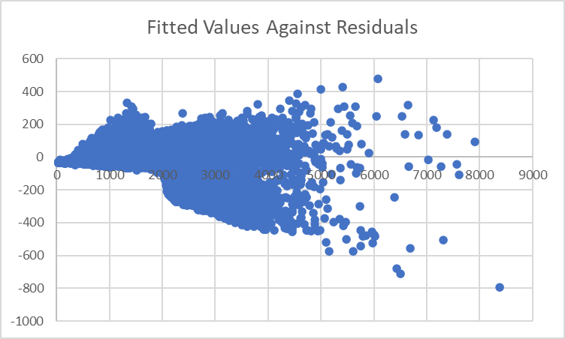
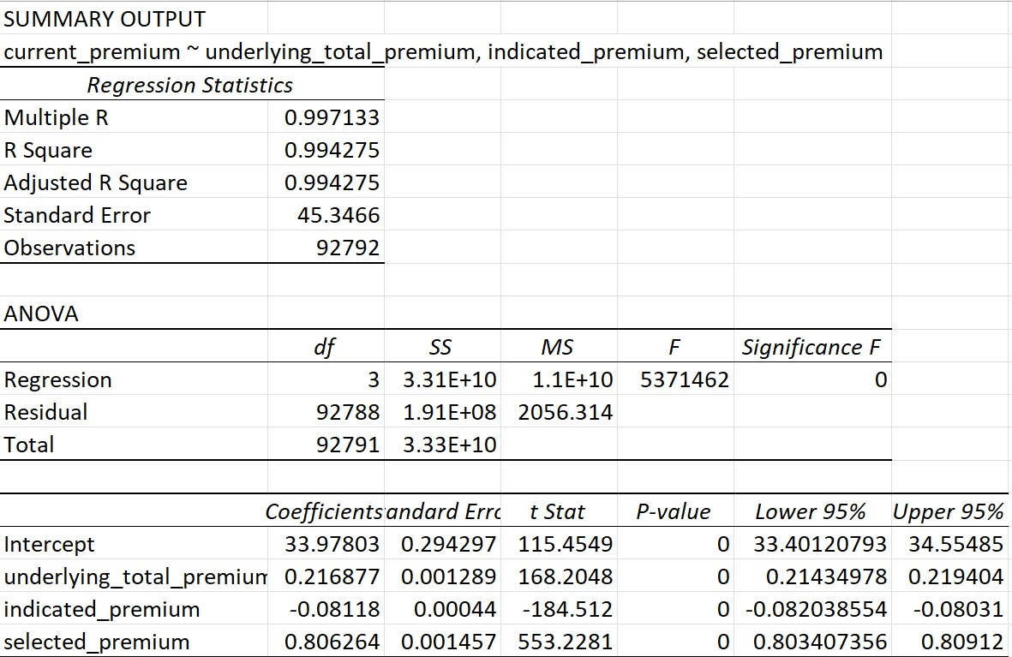
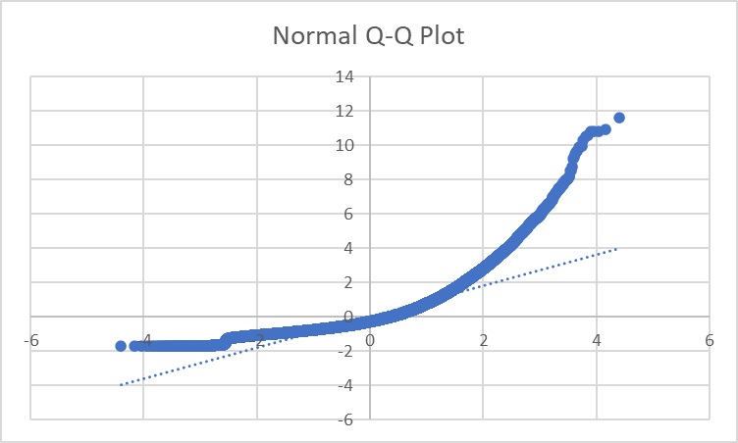
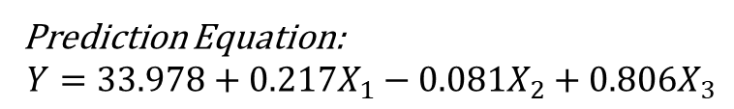
Initial Regression Model Results
Prediction Equation:
$$Y=33.978+0.217X_{1}−0.081X_{2}+0.806X_{3}$$

Slide 8
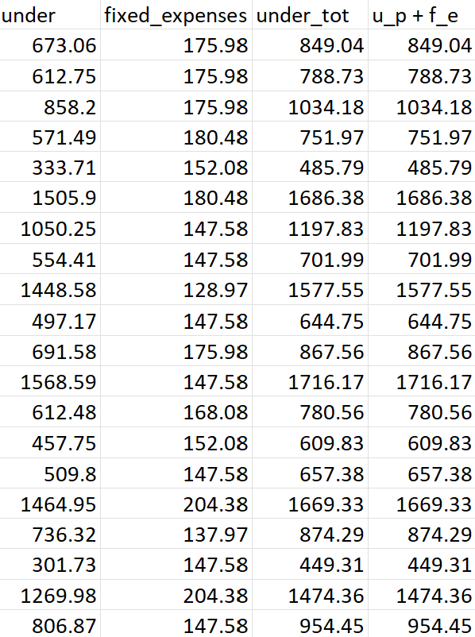
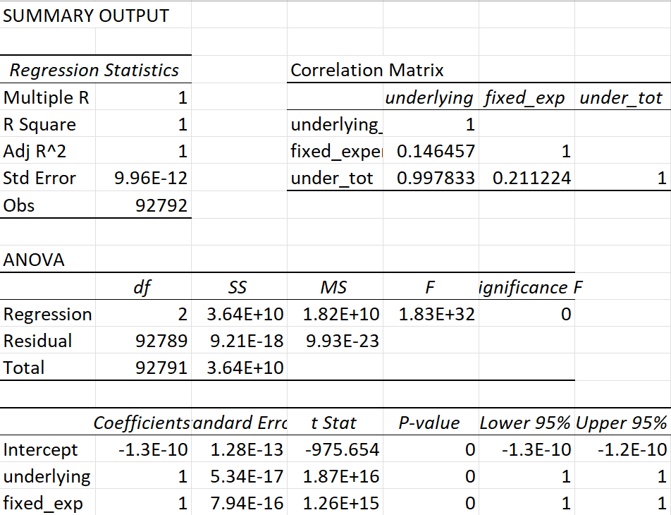
Underlying Total Premium
Underlying_total_premium = underlying_premium + fixed expenses

Slide 9
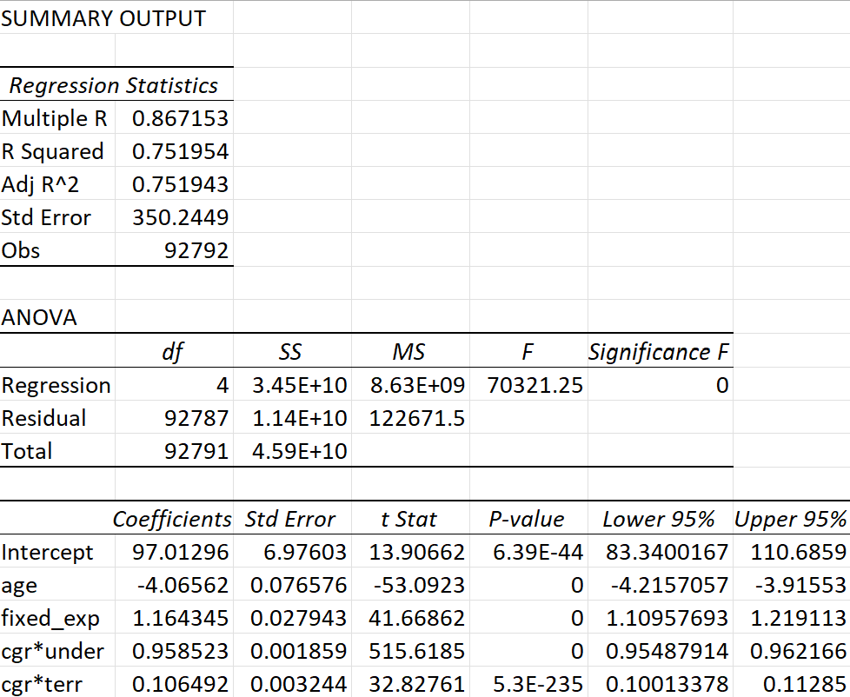
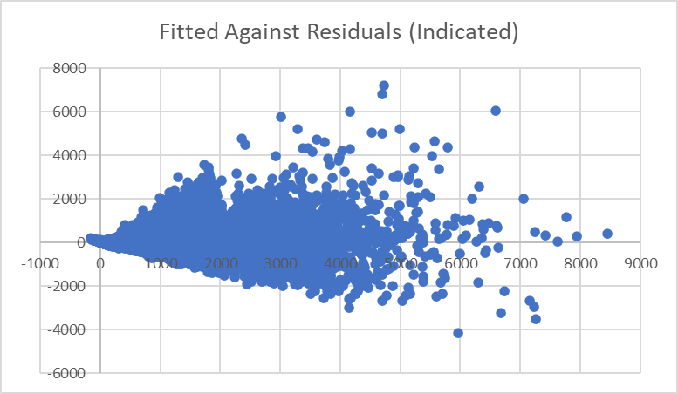
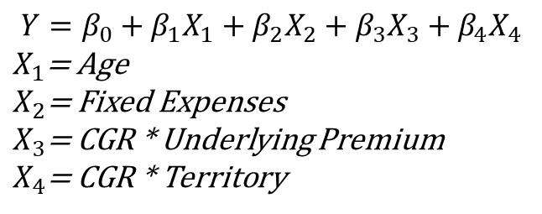
Indicated Premium
$$Y=β_{0}+β_{1}X_{1}+β_{2}X_{2}+β_{3}X_{3}+β_{4}X_{4}$$
$X_{1}$= Age
$X_{2}$= Fixed Expenses
$X_{3}$= CGR * Underlying Premium
$X_{4}$= CGR * Territory

Slide 10
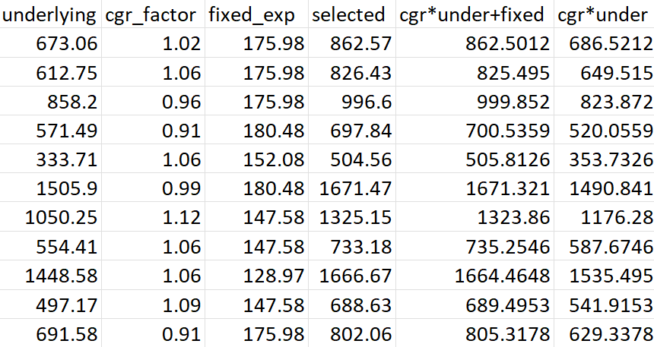
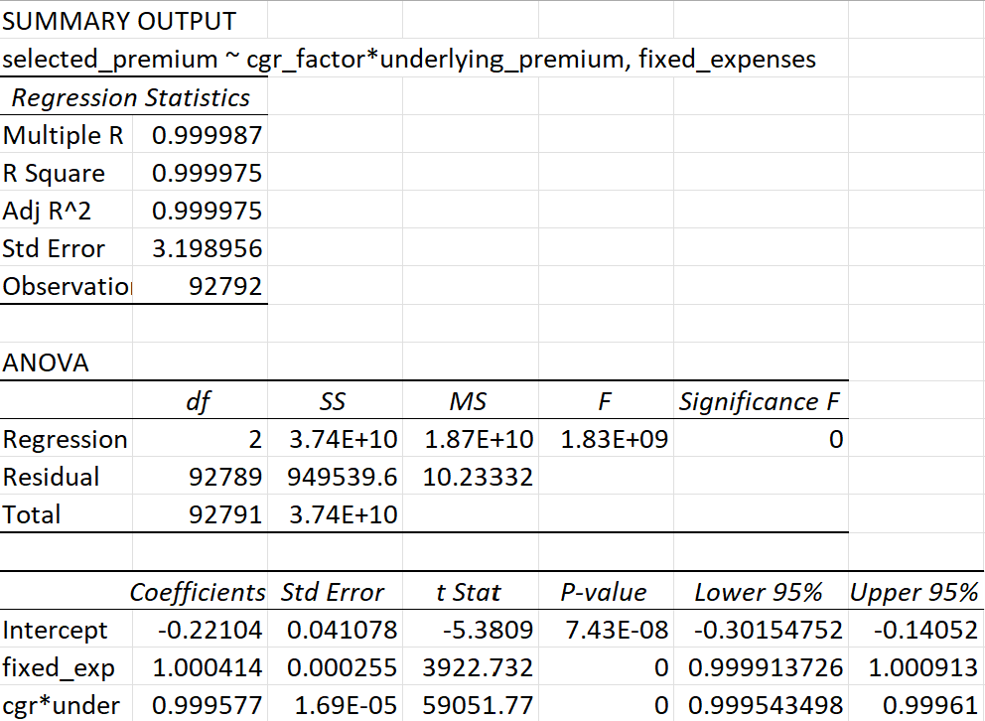
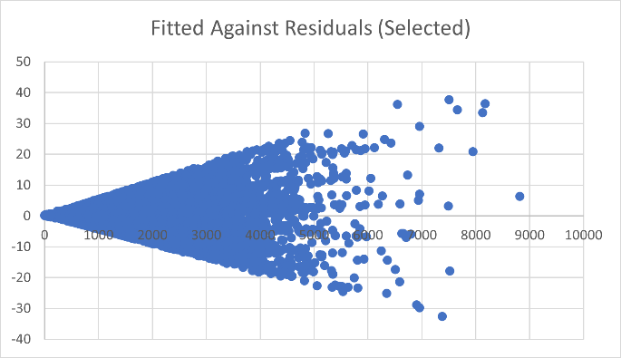
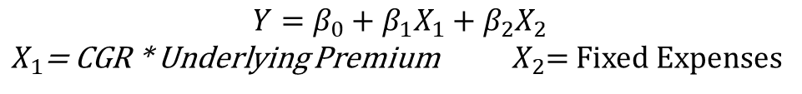
Selected Premium
Selected Premium ≈ CGR x Underlying Premium + Fixed Expenses
$$Y=β_{0}+β_{1}X_{1}+β_{2}X_{2}$$
$X_{1}$= CGR * Underlying Premium $X_{2}$= Fixed Expenses

Slide 11
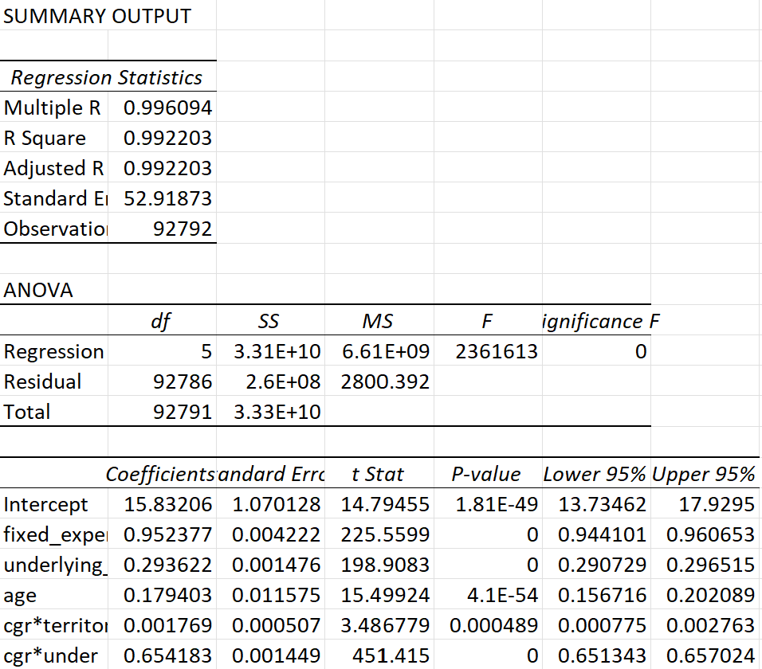
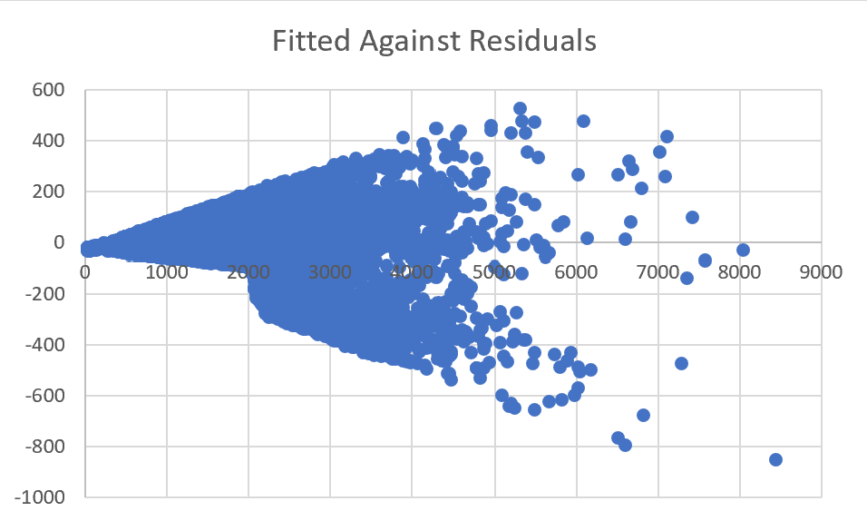
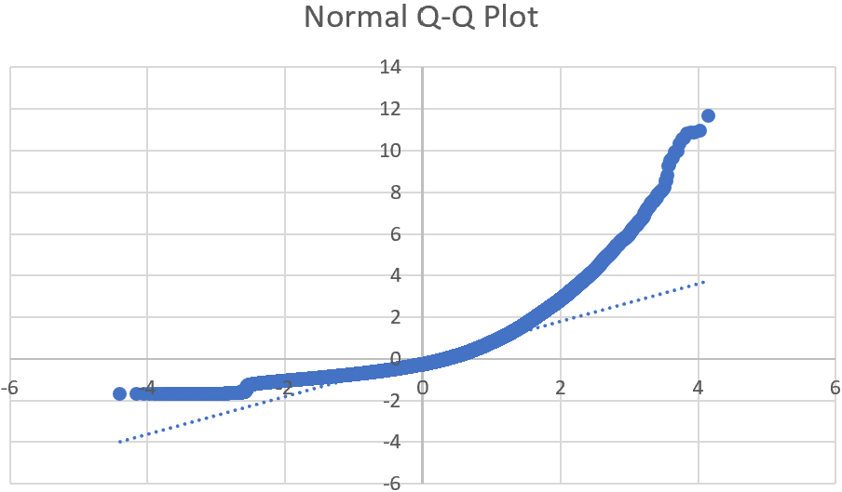
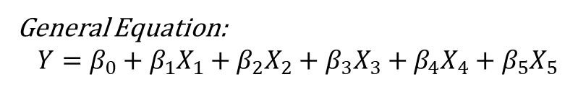
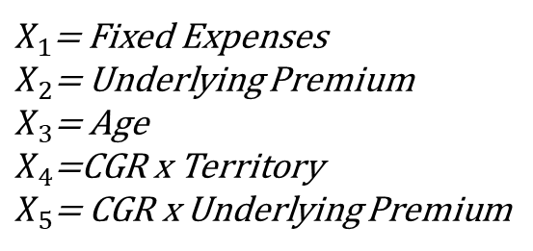
Culminating Regression Model
General Equation:
$$Y=β_{0}+β_{1}X_{1}+β_{2}X_{2}+β_{3}X_{3}+β_{4}X_{4}+β_{5}X_{5}$$
$X_{1}$= Fixed Expenses
$X_{2}$= Underlying Premium
$X_{3}$= Age
$X_{4}$=CGR x Territory
$X_{5}$= CGR x Underlying Premium
Prediction Equation:
$$Y=15.832+0.952X_{1}+0.294X_{2}+0.179X_{3}+0.0002X_{4}+0.654X_{5}$$

Slide 12
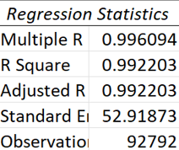
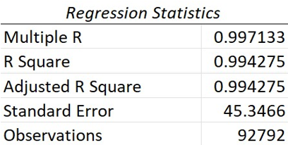
Statistical Analysis & Comparison
Final Regression
Initial Regression

Slide 13
Model Constraints & Limitations
Missing the complete list of factors involved in policy underwriting
Location, Vehicle, Driver Statistics, Personal Data and Insurance History
Indicated premium solely based on approximating regression
Discounts factor not included that effect the current premium
No information available on age ranges
Junior, Senior, Optimal Age
Not enough data to use all factors included: Gender, YPC
Gender should be weighted against age ranges
Did not model with held variables
Sampling data according age ranges or YPC
Lack of experience in actuarial science
Model constructed based solely on data/information available

Slide 14
Conclusion
In building the cumulative regression model for current premium, it was quite apparent that the underlying premium was the most common and influential factor.
Formulating the underlying premium accounts for most of the missing factors from the previous slide: specific location details, type of vehicle, etc.
Awareness of what contributes to auto insurance premiums can assist consumers in making optimal insurance choices. In addition, consumers should also research, or be aware of, their area statistics.

Slide 15
References
Devastator, T. (2022, November 15). Car insurance. Kaggle. https://www.kaggle.com/datasets/thedevastator/insurance-companies-secret-sauce-finally-exposed?resource=download&select=cgr-definitions-table.csv
Insurance Information Institute. (2020). What determines the price of an auto insurance policy? | III. Iii.org. https://www.iii.org/article/what-determines-price-my-auto-insurance-policy
Subject premium. Insuranceopedia. (2023a, June 9). https://www.insuranceopedia.com/definition/4391/subject-premium#:~:text=A%20subject%20premium%20is%20the,it%20by%20their%20reinsurance%20rate
Underlying policy. Insuranceopedia. (2023b, June 9). https://www.insuranceopedia.com/definition/4687/underlying-policy

